Slide 1
Monetary Authority of Singapore Financial Sector Technology & Innovation (FSTI) Scheme Proof-of-concepts
Inclusive Cross-Border Remittances
Making remittance cheaper and faster
09.03.2023

Slide 2
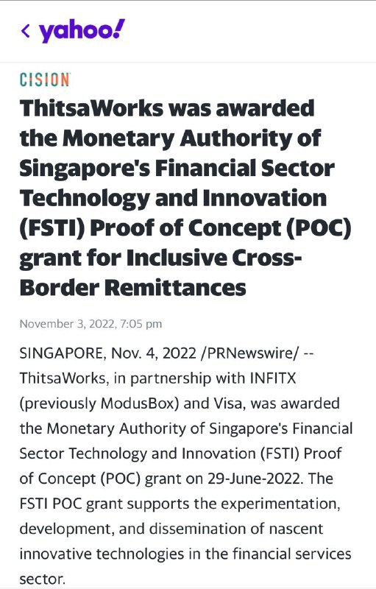












Proof of Concept
Myanmar-based Wallet
Singapore-based Wallet
Philippines-based Wallet

Slide 3

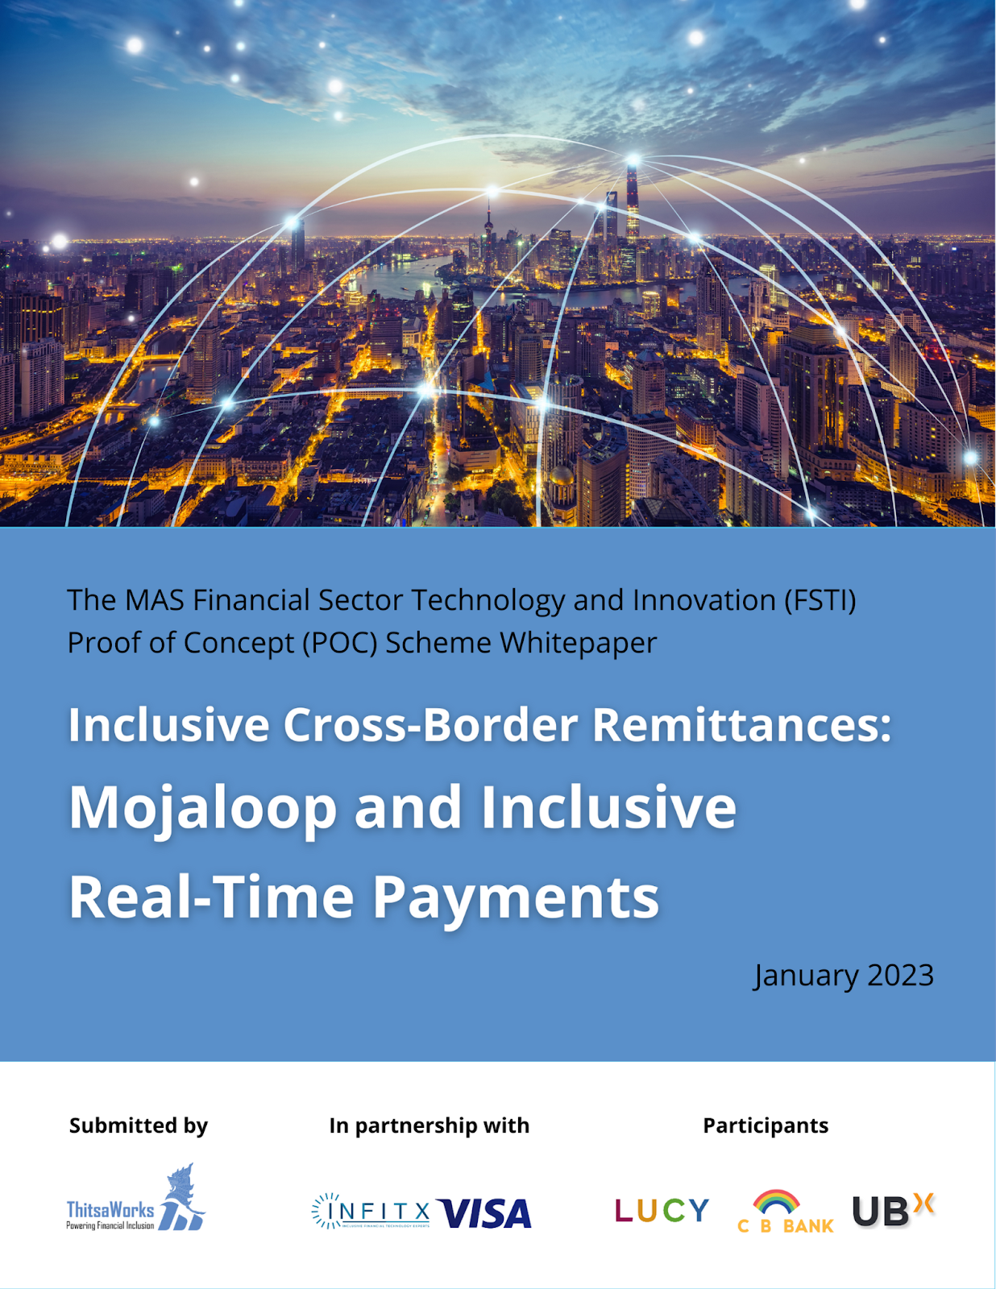
Participants

Slide 4
The Problem
While many remittance options exist for overseas migrant workers in Singapore, options to reach rural areas, where many of the workers' families live, are complicated, expensive, and slow.
1
It is impossible to send money directly to friends and family if they hold accounts at microfinance institutions, rural banks and most wallets.
2

Slide 5
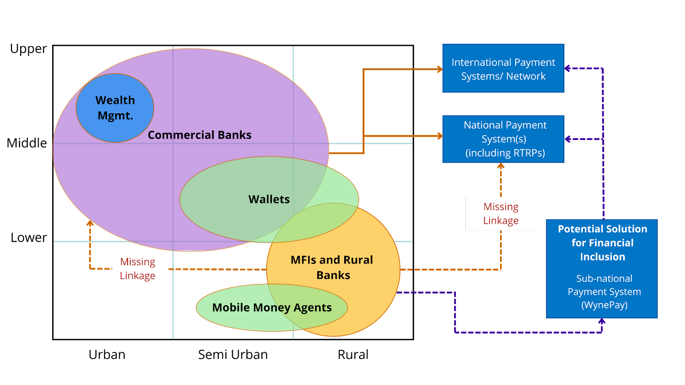


Slide 6



Goals
To connect small financial institutions to real time payment networks to enable fast, convenient, and ubiquitous cross-border remittances.
To create a replicable, scalable model for regional payment networks that can be taken to other markets, leveraging Singapore’s position as a regional innovation and financial hub.​
To explore opportunities to make remittance cheaper and faster for the Singapore-to-Philippines and Singapore-to-Myanmar corridors.​

Slide 7
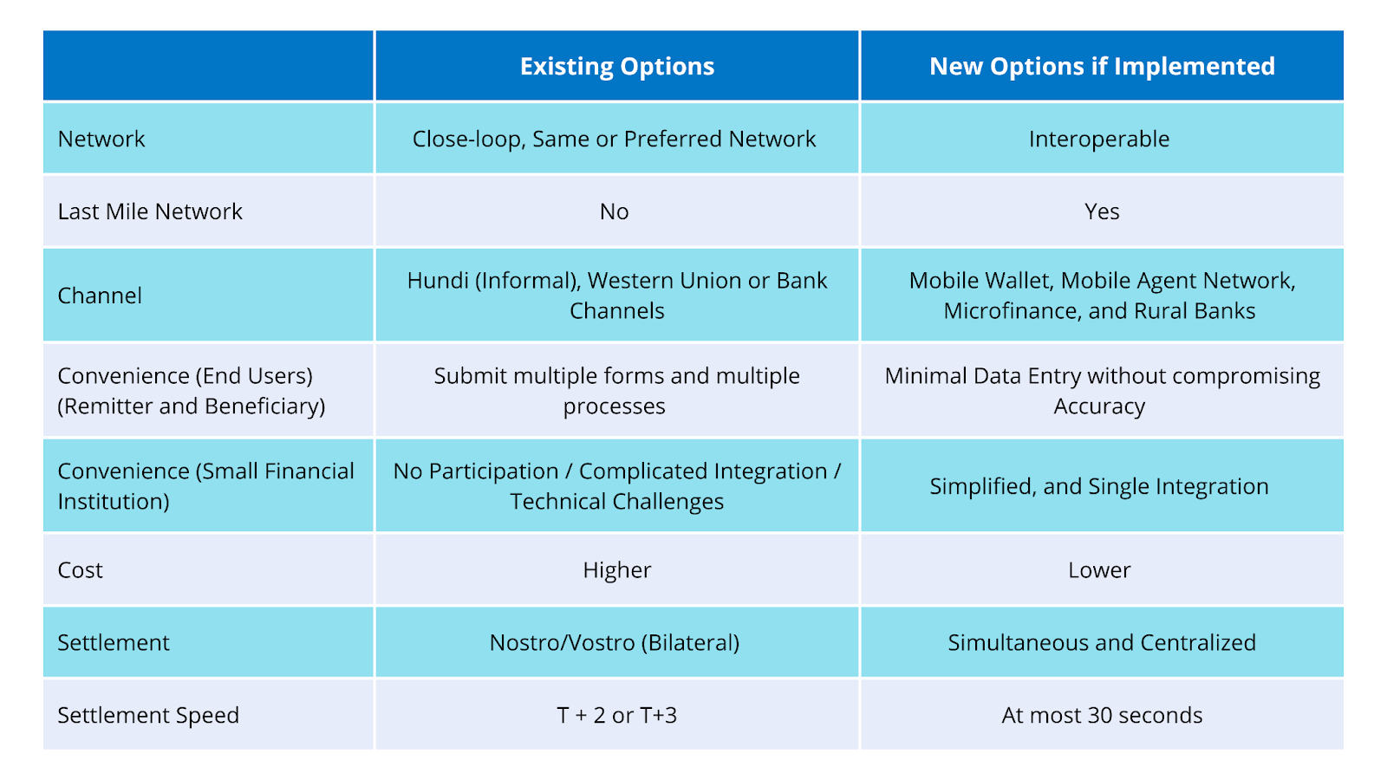
Envisioning Steady-State Success
SOURCE: ThittsaWorks Research; PayNow-PromptPay Linkage Whitepaper: A Playbook for ASEAN and the World

Slide 8
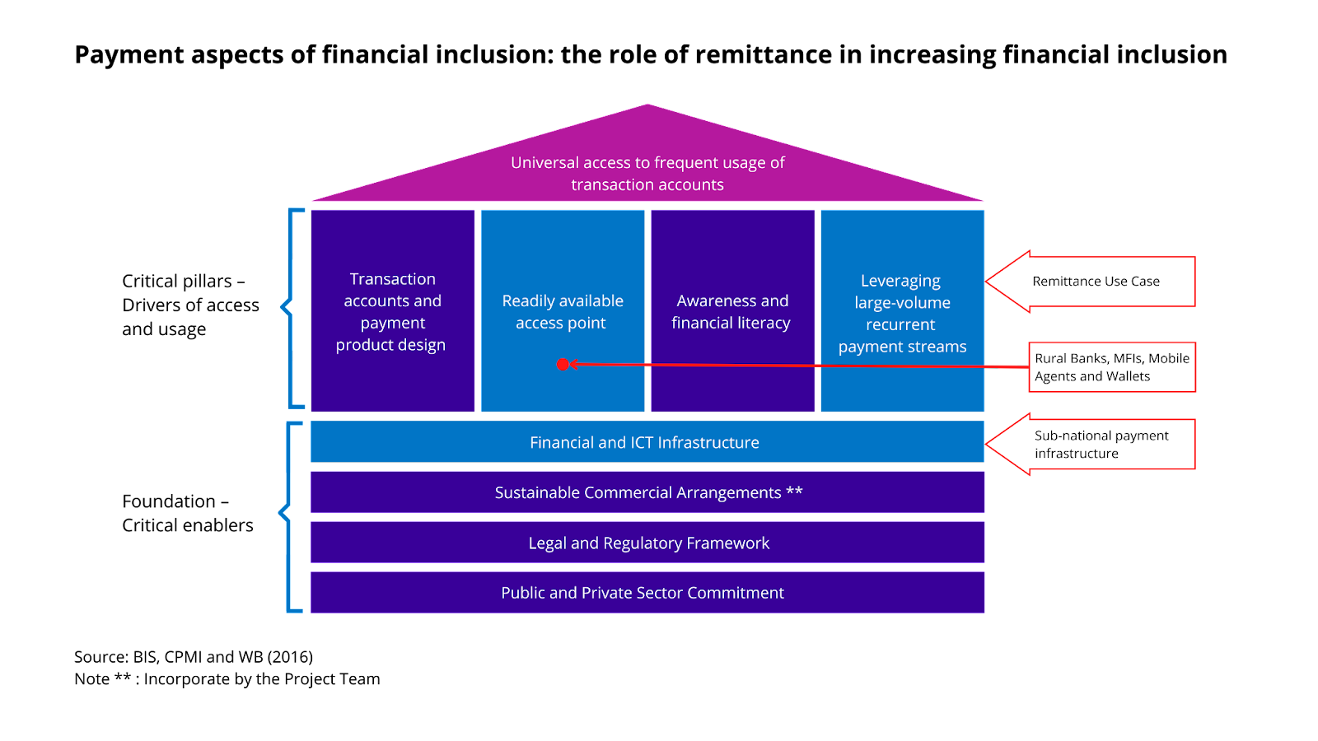
Project Scope

Slide 9
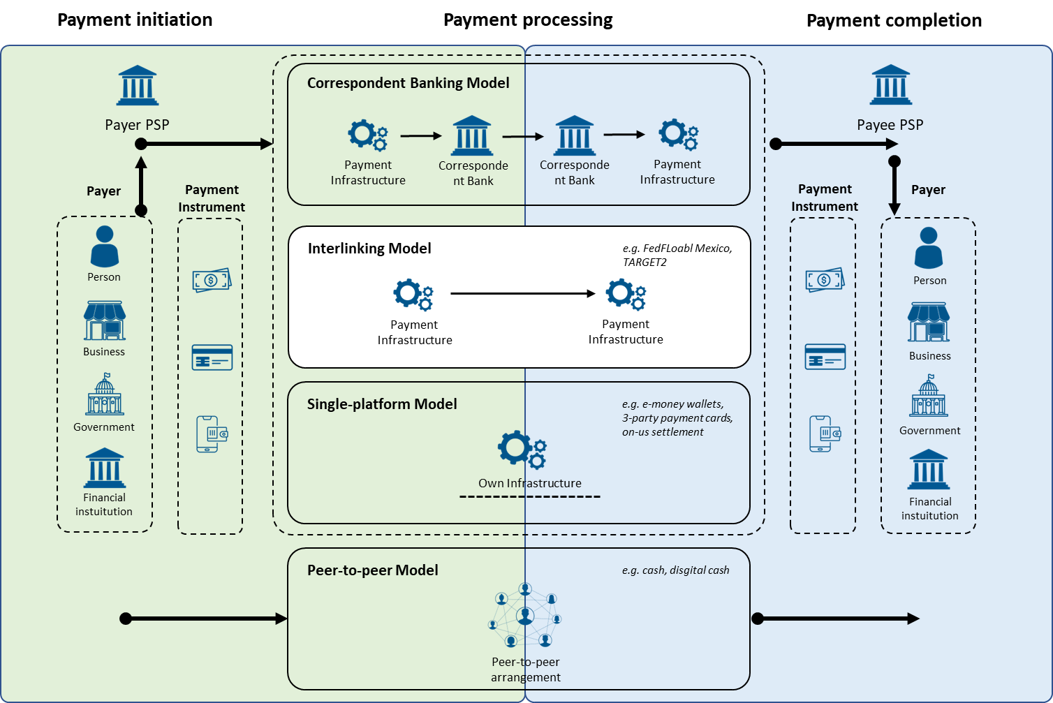
Proposed Scope vs Alternatives

Slide 10
System Design

Slide 11
Strategic Goals (Design Principles)
A catalyst for Financial Inclusion
Design for target end users (rural, low-income residences)
Speed to Market as a priority
Replicable and Scalable Blueprint

Slide 12
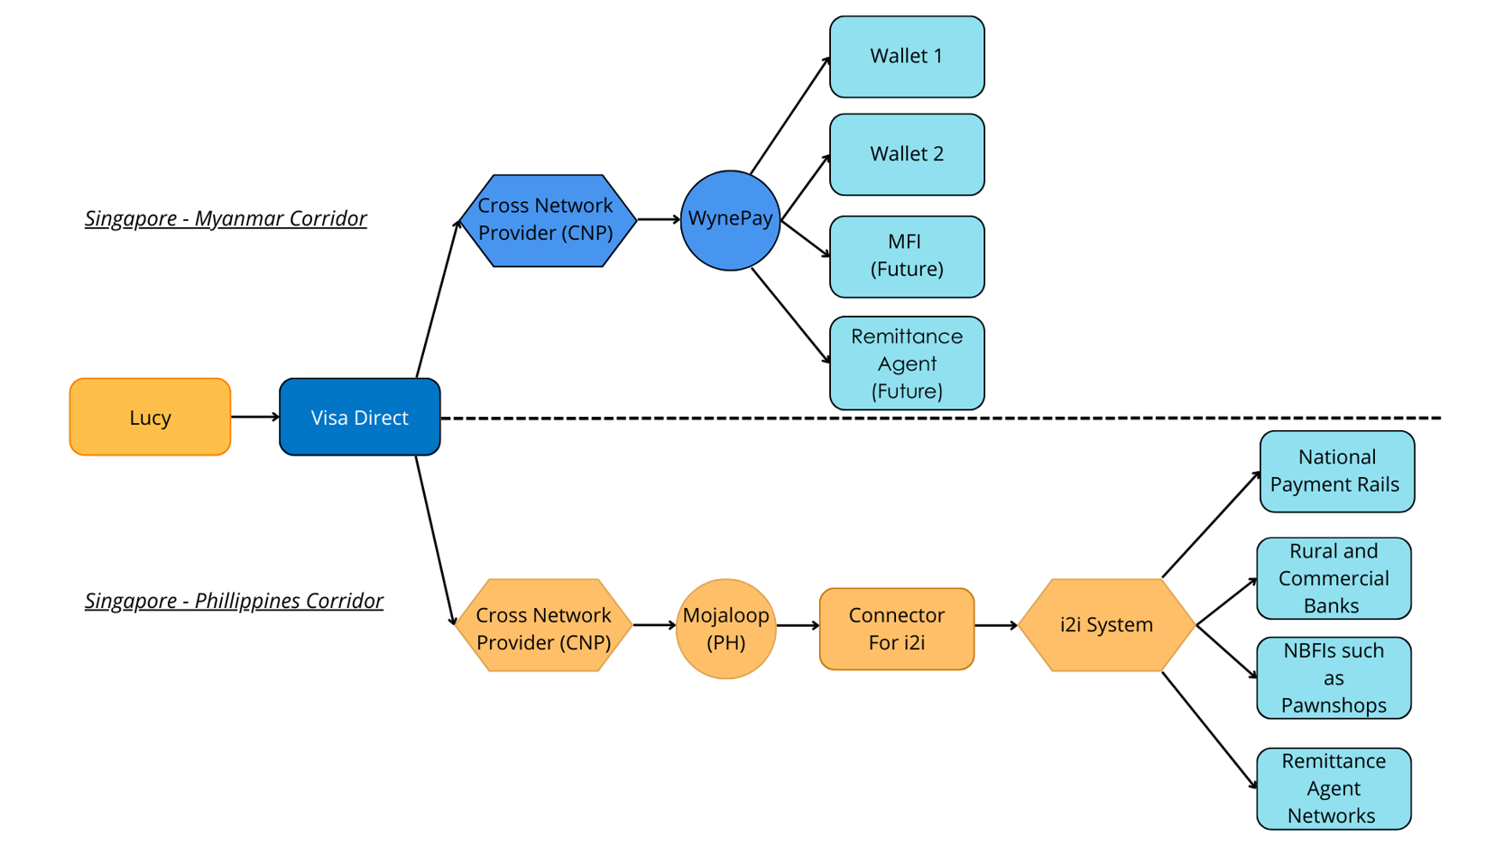
Architecture of the Proposed Solution

Slide 13
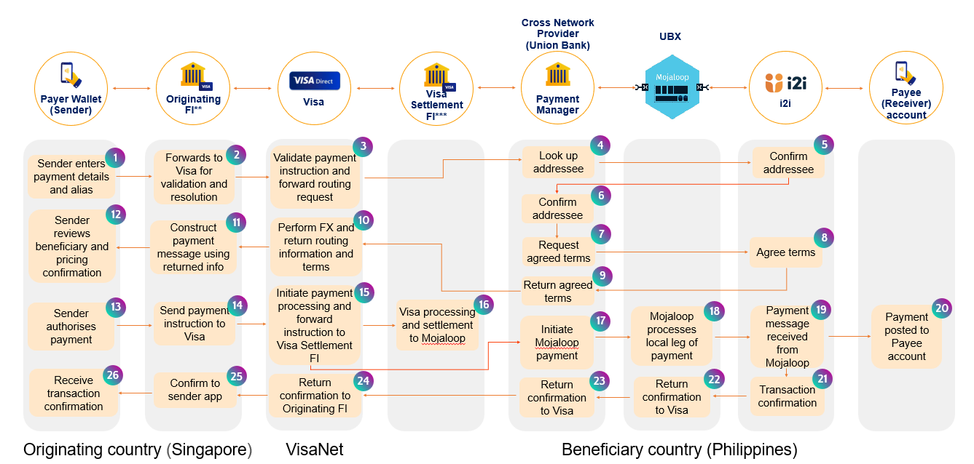
Detailed System Design
Step -1: Payment Initiation
Step -2: Alias Lookup/ Resolution
Step -3: Payer Confirms and Transaction
Step -4: Clearing / Settlement
Step -5: Transaction Confirmation

Slide 14


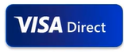



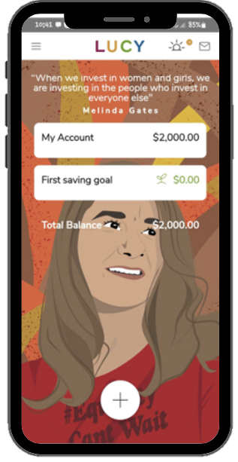
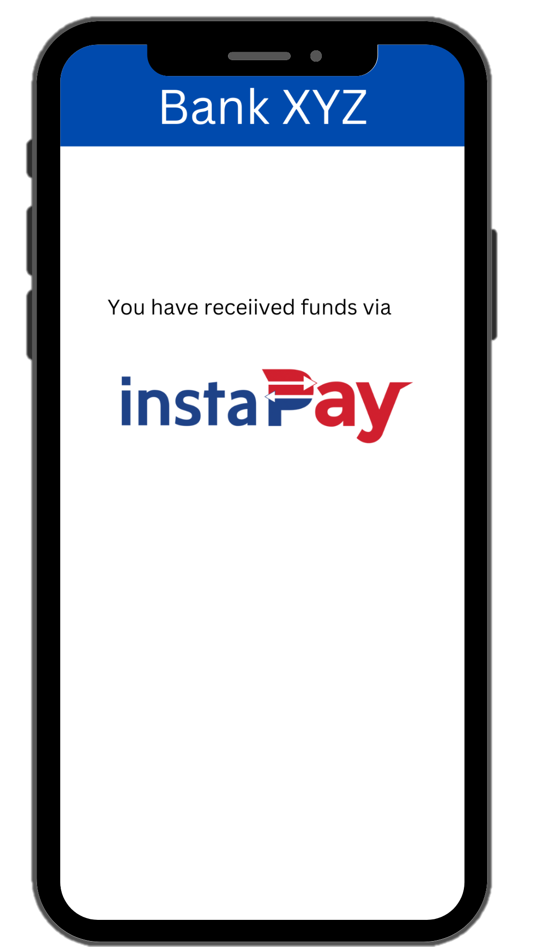


Objective of POC
Cross Network Provider
(Union Bank)
UBX
Payer Wallet (Sender)
Originating FI**
Visa
Visa Settlement FI***
Payment Manager
Payee (Receiver)
account
i2i
(Lucy)
SGD 100 Sent
PHP 4,000 Received
(E-wallet)

Slide 15
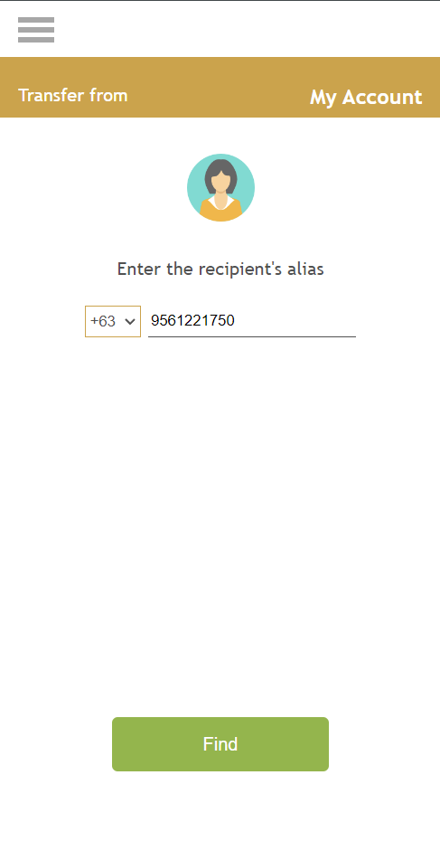

Address Resolution (Sender – LUCY)
Cross Network Provider
(Union Bank)
UBX
Payer Wallet (Sender)
Originating FI**
Visa
Visa Settlement FI***
Payment Manager
Payee (Receiver)
account
i2i
Alias Resolve Request
1
Alias Resolve Response
1
2
{alias: “+639561221750", aliasType: "01", primaryAccountNumber: “7000110622011110",…}
alias: "+639561221750“
aliasType: "01“
cardType: "Visa Classic“
city: “Manila“
country: “PH“
issuerName: “UnionBank of the Philippines“
name: “Jonna Jose“
postalCode: "80130“
primaryAccountNumber: "7000110622011110"
2
(Lucy)

Slide 16
Address Resolution (Sender – LUCY)
Cross Network Provider
(Union Bank)
UBX
Payer Wallet (Sender)
Originating FI**
Visa
Visa Settlement FI***
Payment Manager
Payee (Receiver)
account
i2i
PushFunds transaction request
3
3
PushFunds transaction response
4
{responseCode: "00", receiverTransactionId:"381228649430015",…}
mojalooptransferId: "4ef361ad-7f22-4c79-8ee0-dbadc61d7a31"
receiverTransactionId: "381228649430015"
responseCode: "00"
4
(Lucy)

Slide 17
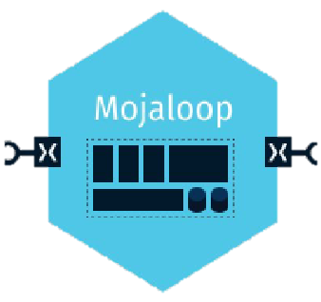
Making Payment
Cross Network Provider
(Union Bank)
UBX
Payer Wallet (Sender)
Originating FI**
Visa
Visa Settlement FI***
Payment Manager
Payee (Receiver)
account
i2i
Core Connector
1
Post/receiveOCT request
Sending request from CNP’s core connector Get/Parties/ALIAS/9561221750 Getting response from recipient DFSP
Put/Parties/ALIAS/9561221750
2
2
2
Payment Manger
for i2i
1
2
3
3
3
3
Mojaloop Connector

Slide 18
Making Payment
Cross Network Provider
(Union Bank)
UBX
Payer Wallet (Sender)
Originating FI**
Visa
Visa Settlement FI***
Payment Manager
Payee (Receiver)
account
i2i
Core Connector
Sending putTransfer request to mojaloop connector
"body": "{\"acceptParty\":true}”
POST /quotes
PUT /quotes/{id}
Received putTransfer response from mojaloop connector
4
5
5
Payment Manger
for i2i
4
5
7
6
6
6
7
Mojaloop Connector

Slide 19
Making Payment
Cross Network Provider
(Union Bank)
UBX
Payer Wallet (Sender)
Originating FI**
Visa
Visa Settlement FI***
Payment Manager
Payee (Receiver)
account
i2i
8
Sending putTransfer request to mojaloop connector
"body": "{\"acceptQuote\":true}“
POST /transfers
PUT /transfers/{id}
Received putTransfer response from mojaloop connector
Converted response to VISA format
Core Connector
9
9
9
Payment Manger
for i2i
12
8
10
11
11
10
10
Mojaloop Connector
12

Slide 20



Innovations
Cross Network Provider (CNP)
Multiple Alias Oracle
Settlement Model #2 (MVP)

Slide 21
Cross Network Provider (CNP)
An instance of the adapter pattern, used when an incompatible module needs to be integrated with an existing module without making any source code modifications. CNP is needed to route messages between schemes and to act as a proxy for one scheme in the other scheme for non-repudiation checking, liquidity cover, settlement and directory look-up.

Slide 22
What happens in the CNP?
Cross Network Provider
Convert message format
Sign message
Encrypt message
Convert message format
Non-repudiation check
Decrypt message

Slide 23
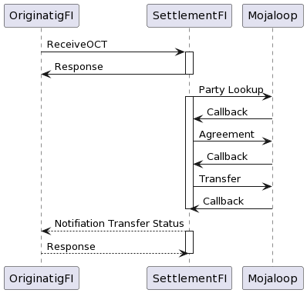
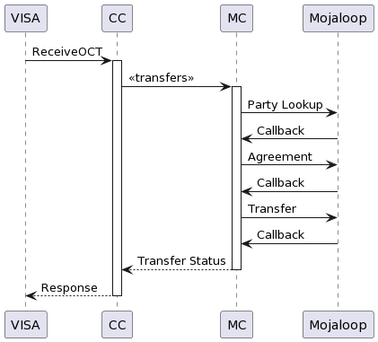
Cross Network Provider (CNP)
Asynchronous
Synchronous

Slide 24
Multiple Alias Oracle
Objective: To facilitate Account Lookup Services across two different payment systems

Slide 25
Problem
Typically, it is assumed that the identifiers used to locate the institution which administers a particular account are unique within a payment system.
In some cases (for instance, an IBAN in the jurisdictions where they are used) this is a reliable assumption.
In others (for instance, an MSISDN) it is not reliable.
Users can belong to more than one mobile money service provider, or different family members might share a handset.
Thus, the MSISDN does not uniquely identify a mobile money system.

Slide 26
Solution
To find a way for the system to understand which mobile money system to route an address resolution request to:
There are two ways in which it has been solved. Prefix Oracle and Alias Oracle.
Solving the problem for domestic transfer with Prefix Oracle:
In a Mojaloop scheme, end user applications already allow the customer to select which Mobile Money System they want to send to.
The prefix oracle allows -
The sending FI to include the information in the address resolution request (to do name resolution and to confirm that the account is active)

Slide 27
Solution
Solving the problem for Cross Border Remittance with Alias Oracle:
The sending party will have no idea which Mobile Money System owns the beneficiary’s account and their application won’t know about the alternative ones which are available.
The alias oracle allows -
Resolve (and assign) which financial institutions (DFSP - wallet or MFIs) to route the payment by first sending the address resolution to the respective repository;
Receive a confirmation of which financial institution to intermediate the payment
The user (payee) to change the associated / preferred financial institution (DFSP) associated with the alias phone number (MSISDN) to be changed

Slide 28
Choosing preferred wallet provider
When it comes to the preferred wallet provider, two options were considered:
Default Preferred Setting Method via Wallet Provider,
Default Setting Method via latest registration
Assessing the pros and cons of both options, the project team opted for option 2 for this POC.
Default Setting Method via latest registration,
The system automatically assigns the latest DFSP (wallet or MFI/Rural Bank) the recipient onboarded.
Pros
Cons
Simple design
Simple to set up
Reasonably efficient while participant numbers are low
No additional changes require from any of the participants
The recipient (payee) will need to register the preferred DFSP (wallet or MFI/Rural Bank).
the payee may not be aware that the preferred DFSP (*wallet) was changed due to the latest registration method if the necessary information was not acknowledged to the payee after the registration.

Slide 29


User Journey affect on Oracle
1) User first time registration
CBPay Wallet
Mojaloop Switch
Mojaloop MSISDN Oracle
I want to open a mobile wallet.
This is my MSISDN +959254458964
Please register to MSISDN to me.
Post participants /MSISDN/ +959254458964
Please register +959254458964 to CBPay.
Post participants /MSISDN/ +959254458964
Do I have registration already?
No, I don’t. I will register it to CBPay and set it as the default for this MSISDN

Slide 30
User Journey affect on Oracle
1) User first time registration
OKDollar Wallet
Mojaloop Switch
Mojaloop MSISDN Oracle
I want to open a mobile wallet.
This is my MSISDN +959254458964
Please register to MSISDN to me.
Post participants /MSISDN/ +959254458964
Please register +959254458964 to OKDollar.
Post participants /MSISDN/ +959254458964
Do I have registration already?
Yes, I do. But I will register it to OKDollar and set it as the default for this MSISDN

Slide 31
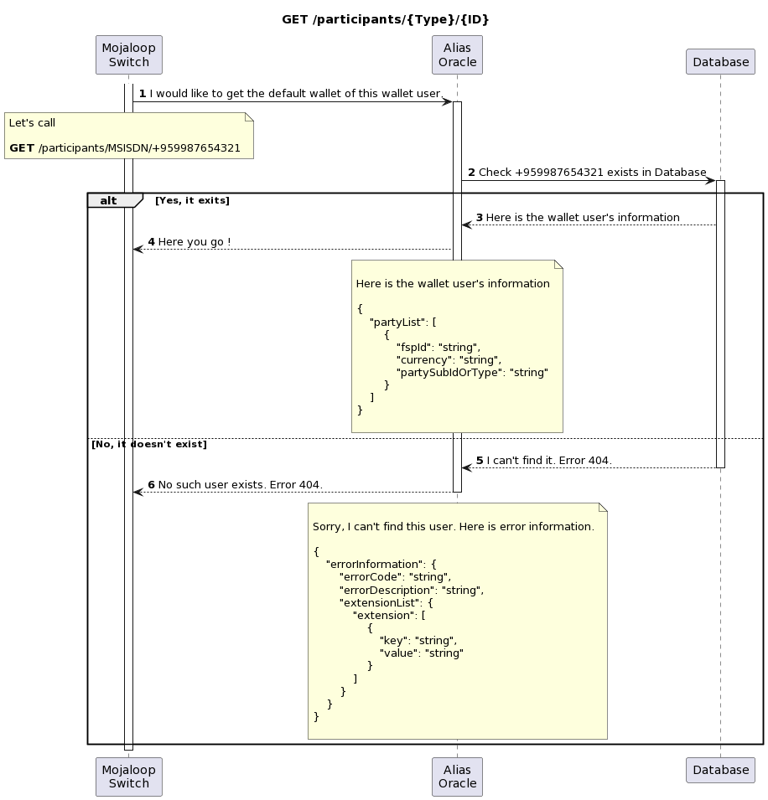
GET-participants-from-Oracle

Slide 32
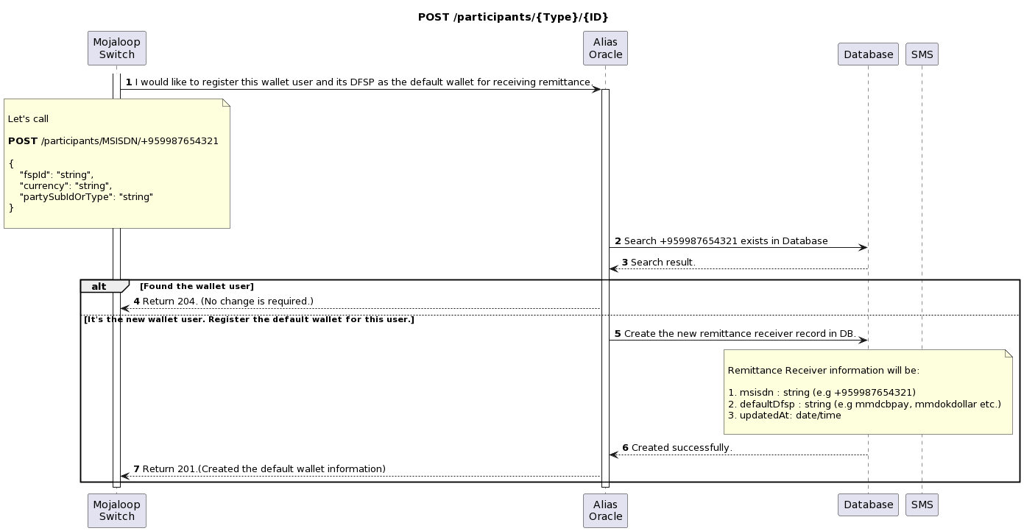
POST-participants-to-Oracle

Slide 33
Settlement

Slide 34
Problem
The Mojaloop platform is only concerned with a single settlement structure.
In a cross-border remittance, funds will typically arrive from another scheme on a timetable which is not related to the remittee (payee) scheme’s settlement timetable. This is likely to place significant liquidity pressure on the CNP as a settling participant in the remitter (payer) scheme.
As a result, there is a requirement to distinguish between internal transfers and remittance transfers and settle them according to separate settlement models.

Slide 35
Solution
There are two possibilities that are considered for this POC,
Use an identifier type which is specific to external transfers (This would enable participants to register their customers separately for the receipt of remittances which would enable the participant to collect appropriate KYC but it would need modifications to the partyIdType)
Use the subScenario element of the TransactionType object
In both cases,
The appropriate value would be set for inbound transfers by the CNP, and
There is no change needed to the behavior of creditor DFSPs and ultimate creditor.
We can already define settlement models by ledger account type. We can apply a rule on transfer prepare which:
Reads the content of the transfer
Assigns ledger account types based on the content
By default, assigns the current account types. Now all our remittances can be settled separately.

Slide 36
Next steps

Slide 37
Technical Challenges to Investigate Further
Directory Structures in an Interconnected System
Duplicate Identifiers
Settlement Models
KYC Information
Fees
Connecting to Blockchain-based Payment Networks

Slide 38
Next phase of the project…
To fully market this solution and convert this POC into a commercially sustainable solution, the next phase of the project would be:
To perform end-to-end testing (in certification environment) with full clearance of remitted funds within the allotted time frame.
The settlement windows of respective payment schemes may not coincide, potentially resulting in credit risk to one of the settlement banks. Commercial and other risk-mitigation arrangements such as interbank credit lines can be leveraged to resolve these types of issues.
A stronger focus on regulatory and compliance requirements. The focus for this proof of concept project was more the development of a technical solution. It would be recommended to analyze more on detail financial integrity requirements. Roles and responsibilities, along with agreed standards to abide by in this space would need to be discussed among the key stakeholders, particularly while consensus global on standards like account format or harmonized procedures

Slide 39



Thank you!
info@thitsaworks.com
Fb.me/thitsaworks
thitsaworks.com

Slide 40

High-Level Information Flow (WynePay - CB Bank - Myanmar)
Cross Network Provider
(CB Bank)
ThitsaWorks
Payer Wallet (Sender)
Originating FI**
Visa
Visa Settlement FI***
Payment Manager
Beneficiary Wallet
Payee (Receiver)
account
Validate payment instruction and forward routing request
3
Look up addressee
4
5
Sender enters payment details and alias
1
Forwards to Visa for validation and resolution
2
Confirm addressee
Confirm addressee
6
Sender reviews beneficiary and pricing confirmation
12
11
Perform FX and return routing information and terms
10
Construct payment message using returned info
7
Request agreed terms
Agree terms
8
Return agreed terms
9
Initiate payment processing and forward instruction to Visa Settlement FI
15
Sender authorises payment
13
Send payment instruction to Visa
14
Visa processing and settlement to Mojaloop
16
18
19
20
Initiate Mojaloop payment
17
Mojaloop processes local leg of payment
Payment message received from Mojaloop
Payment posted to Payee account
Receive transaction confirmation
26
25
Confirm to sender app
Return confirmation to Originating FI
24
23
Return confirmation to Visa
22
21
Return confirmation to Visa
Transaction confirmation
Originating country (Singapore)
VisaNet
Beneficiary country (Myanmar)

Slide 41
High-Level Information Flow (Singapore-to-Philippines corridor)
Cross Network Provider
(Union Bank)
UBX
Payer Wallet (Sender)
Originating FI**
Visa
Visa Settlement FI***
Payment Manager
Payee (Receiver)
account
i2i
Validate payment instruction and forward routing request
3
Look up addressee
4
5
Sender enters payment details and alias
1
Forwards to Visa for validation and resolution
2
Confirm addressee
Confirm addressee
6
Sender reviews beneficiary and pricing confirmation
12
11
Perform FX and return routing information and terms
10
Construct payment message using returned info
7
Request agreed terms
Agree terms
8
Return agreed terms
9
Initiate payment processing and forward instruction to Visa Settlement FI
15
Sender authorises payment
13
Send payment instruction to Visa
14
Visa processing and settlement to Mojaloop
16
18
19
20
Initiate Mojaloop payment
17
Mojaloop processes local leg of payment
Payment message received from Mojaloop
Payment posted to Payee account
Receive transaction confirmation
26
25
Confirm to sender app
Return confirmation to Originating FI
24
23
Return confirmation to Visa
22
21
Return confirmation to Visa
Transaction confirmation
Originating country (Singapore)
VisaNet
Beneficiary country (Philippines)

Slide 42
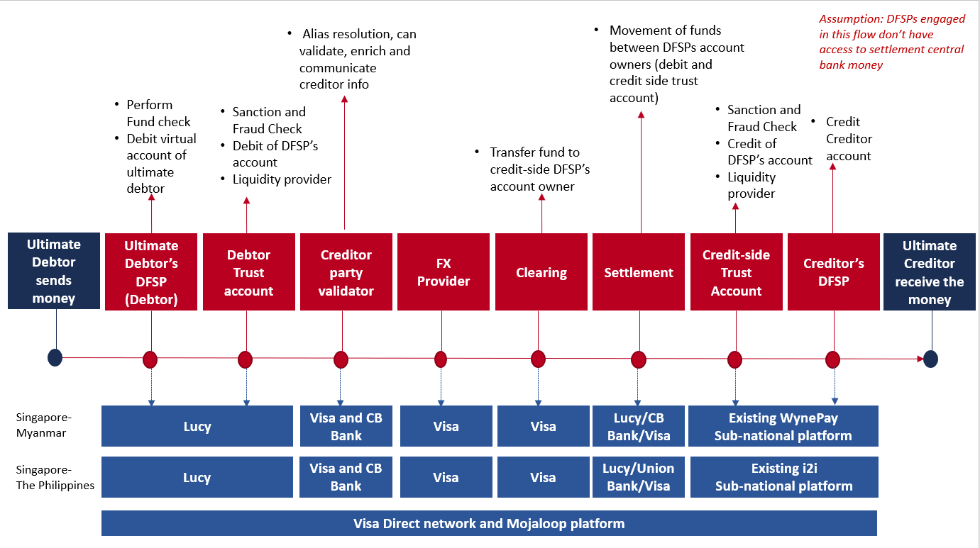
Key Roles within the Process

